Slide 1


Computational Biology – Part 1
Cheng Soon Ong | 8 November 2021 Director Machine Learning and Artificial Intelligence Future Science Platform
Presented to Online Asian Machine Learning School (OAMLS) 2021
e cheng-soon.ong@data61.csiro.au
https://research.csiro.au/mlai-fsp/
Notes:
Key message: Figure out how to use machine learning to assist researchers in scientific discovery.

Slide 2
Given some data
Classify blue plus vs red triangles, based on features

Slide 3
Fit a model to data
Estimate a Gaussian for each class conditional

Slide 4
Build a classifier
Compute the posterior probability of blue plus

Slide 5
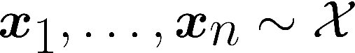

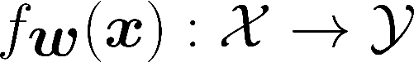
What is Machine Learning?
Machine Learning is about prediction
Examples/covariates/features
Labels/annotations/target variable Predictor
Estimate the best predictor = training
No mechanistic model of the phenomenon
There are many examples
The outcomes (labels) are well defined (usually binary)

Slide 6
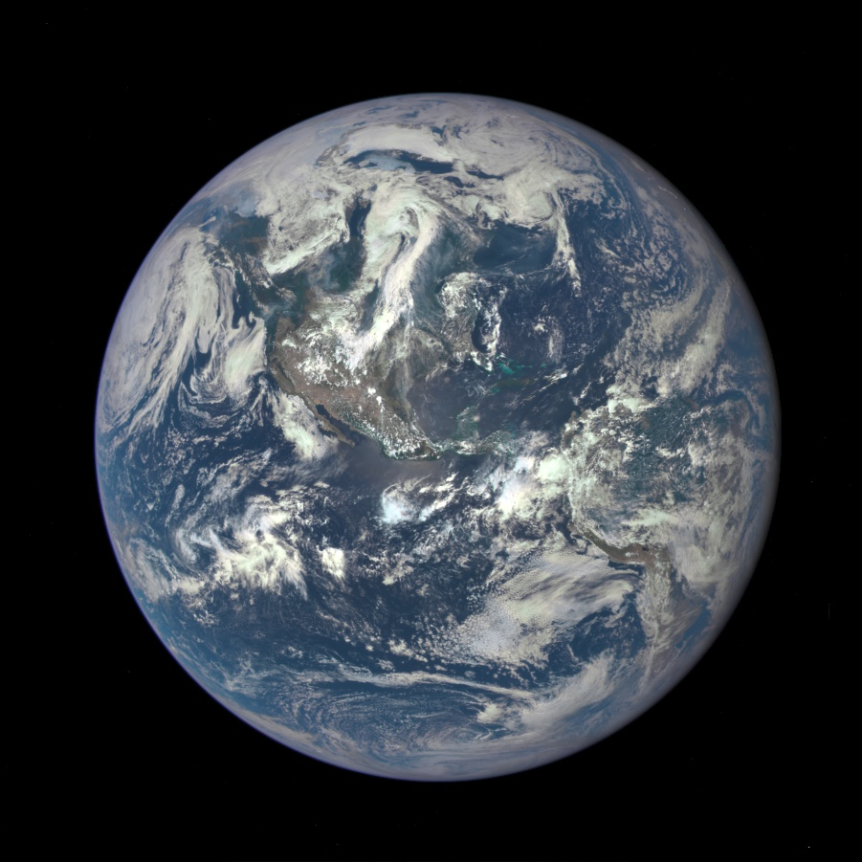
Earth is round, and orbits the sun
https://www.nasa.gov/image-feature/nasa-captures-epic-earth-image

Slide 7
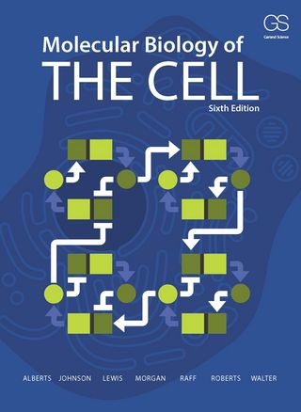
New knowledge about biology
Genomics has given us a new perspective that has demanded a complete recasting and expansion of the material on molecular genetics ...
The traditionally explanatory cartoons that we show on nearly every page of the book generally represent only the primitive first step toward an explanation.

Slide 8
Why machine learning for biological data?
A lot of data
Data is noisy
Large number of features
No precise biological theory
Complex
Let the data do the talking!

Slide 9
Topics for OAMLS 2021
Representing biological sequences (8 Nov 2021)
DNA, RNA, protein sequences have categorical states
Machine learning expects numbers
High dimensions, low sample size (9 Nov 2021)
Sensors are getting cheaper
Samples (e.g. patients) are rare
Designing genomic sequences (may squeeze this in)

Slide 10

What to do with a predictor?

Slide 11
What is Machine Learning?
Assume we have managed to train a sensible predictor
Machine Learning is about prediction
Examples/covariates/features
Labels/annotations/target variable Predictor
Estimate the best predictor = training
No mechanistic model of the phenomenon
There are many examples
The outcomes (labels) are well defined (usually binary)

Slide 12

Assume that domain knowledge is captured by a predictor
Use predictor to decide where to measure (ABCDE)
(A) Active Learning
(B) Bandits / Bayesian Optimisation
(C) Choice Theory
(DE) Design of Experiments

Slide 13
A – Active Learning
Want to build a classifier without paying for a lot of labels
Tran, Ong, Wolf, Combining active learning suggestions, PeerJ 2018

Slide 14
B – Bandits / Bayesian Optimisation
Want to maximise the outcome of different choices
Krause, Ong, Contextual Gaussian Process Bandit Optimization, NIPS 2011

Slide 15
C – Choice Theory
Want to integrate different sources of information
Bedo, Ong, Multivariate Spearman's rho for Aggregating Ranks Using Copulas, JMLR 2016

Slide 16
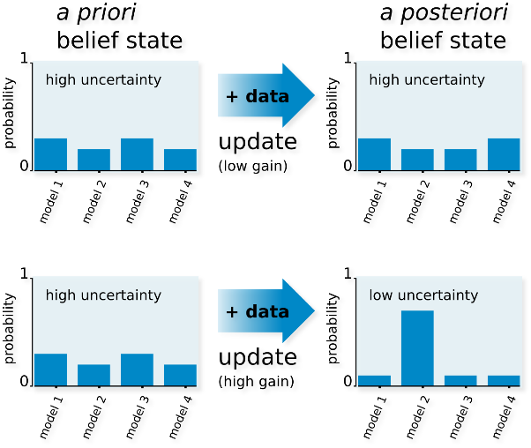
DE – Design of Experiments
Find good models by maximizing information gain
Busetto, et. al. Near-optimal experimental design for model selection in systems biology, Bioinformatics 2013

Slide 17
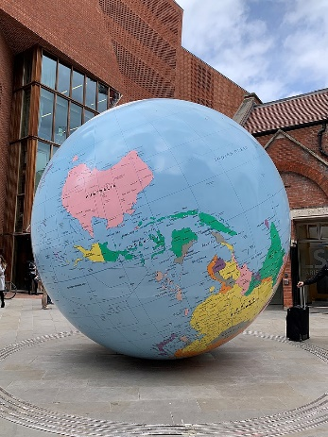
ABCDE: what are we sorting?
A conceptual view of adaptive sampling
Consider the set of all possible things to measure
Think of the predictor output as a generator of features
Each generated features demonstrates the “importance” of a sample
Can get multiple features by a committee or ensemble of predictors
Adaptively choose the next thing to measure by maximising an objective (machine learning is about defining good objective functions)
regularizer
sparsity
bandwidth

Slide 18
ABCDE – what are we sorting?
Illustration of the conceptual idea
Predictor generates features
Define an objective function
A – Active Learning
Predictor generates a confidence that thing is positive
Objective is to find the location where probability = 0.5
B – Bandits / Bayesian Optimization
Predictor generates a model of the reward
Objective combines the summary statistic and uncertainty
C – Choice Theory
Predictor transforms scores into a comparable scale
Objective maximises a multivariate copula score
DE – Design of Experiments
Predictor estimates the expectation over future experiments
Objective identifies the notion of information gain

Slide 19
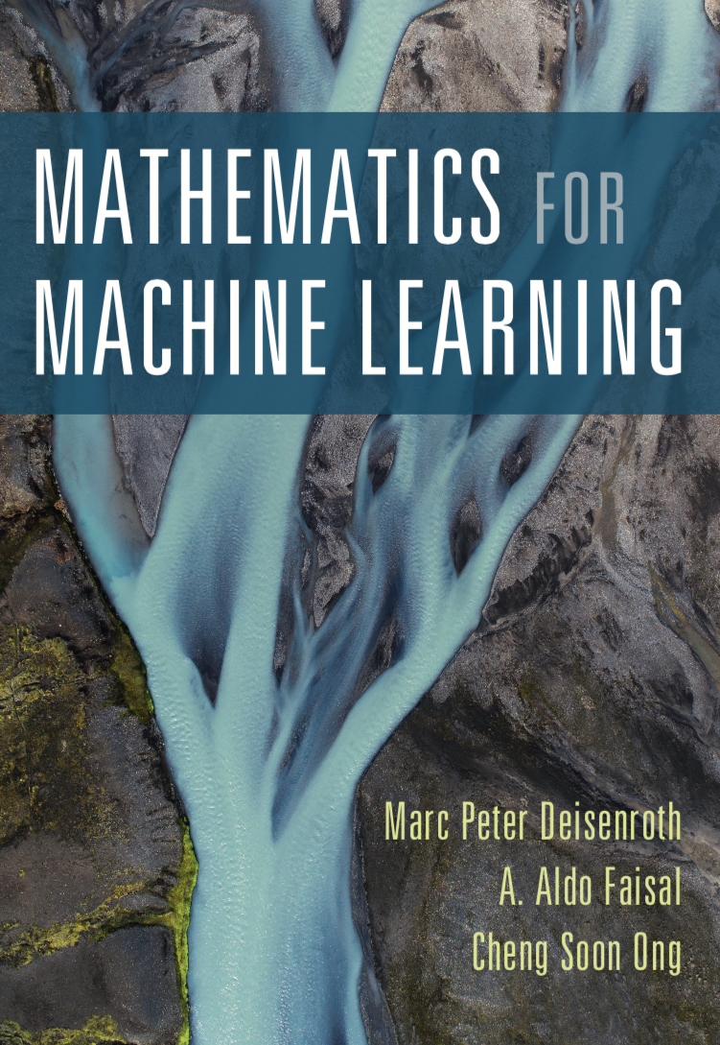

Thank you!
Cheng Soon Ong
e cheng-soon.ong@data61.csiro.au
w ong-home.my
https://research.csiro.au/mlai-fsp/
mml-book.com

Slide 20
Computational Biology – Part 2
Cheng Soon Ong | 9 November 2021 Director Machine Learning and Artificial Intelligence Future Science Platform
Presented to Online Asian Machine Learning School (OAMLS) 2021
e cheng-soon.ong@data61.csiro.au
https://research.csiro.au/mlai-fsp/
Notes:
Key message: Figure out how to use machine learning to assist researchers in scientific discovery.

Slide 21
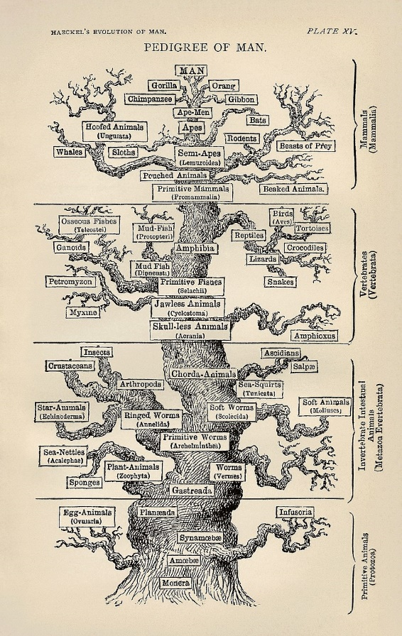
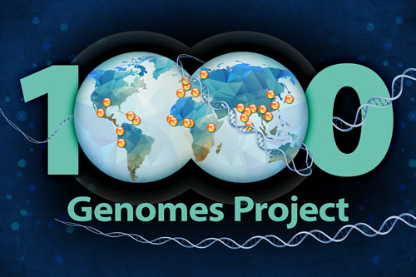
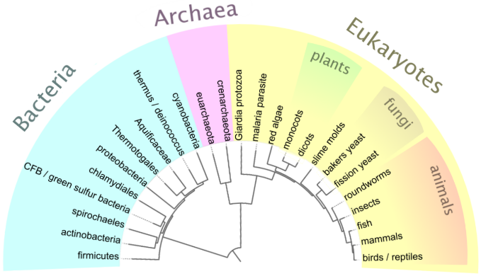
We have the human genome
… but whose one?
Many reasons to study variation
Single gene diseases (cystic fibrosis, Huntington’s, etc)
Complex genetic diseases (hypertension, asthma)
Copy number disorders (e.g trisomy)
Acquired mutations (e.g. UV light damaging skin cells)
Epigenetic modifications (e.g. leukemia)

Slide 22
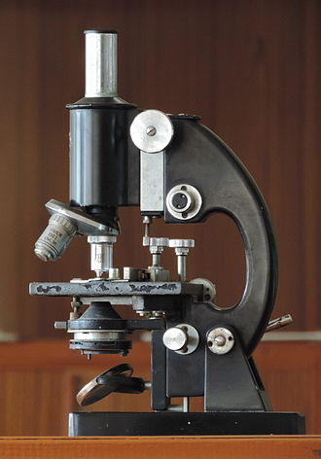
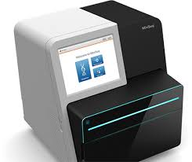
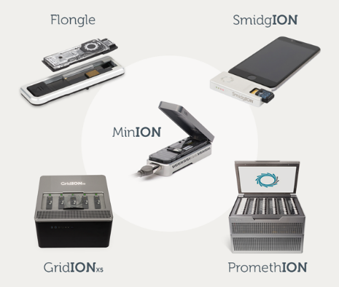
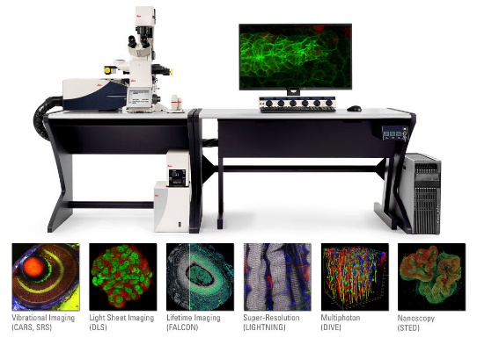
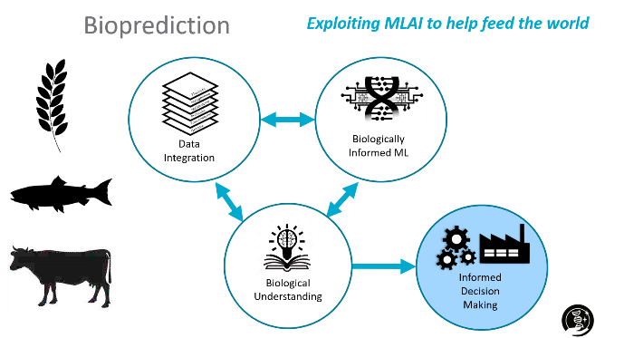
What is a microscope?
Modern biology is a study of systems
Optical
Sequencing
Multi ‘omics
Illumina
Wikipedia
Leica
Oxford nanopore

Slide 23
Why is ML for Comp Bio hard?
Huge opportunity to use computation for scientific discovery
Deep data
High dimensional low sample size data
Finite domain (we want predictions genome wide)
Difficult to satisfy i.i.d. assumption
Prior knowledge
Hard and soft constraints
Causal systems with feedback and delays
Different problems/communities
Genomics, proteomics, medical imaging, health records
Communication challenges

Slide 24
Deep data / fat data / wide data
High dimensional low sample size (big p, small n)
Big data
Wide data
p
p
n
n

Slide 25
Machine learning for scientific discovery
Cheng Soon Ong | 8 November 2021 Director Machine Learning and Artificial Intelligence Future Science Platform
Presented to Online Asian Machine Learning School (OAMLS) 2021
e cheng-soon.ong@data61.csiro.au
https://research.csiro.au/mlai-fsp/
Notes:
Key message: Figure out how to use machine learning to assist researchers in scientific discovery.

Slide 26
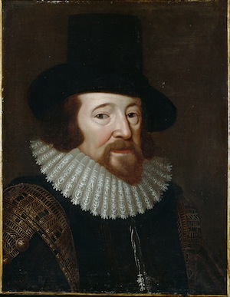
What is scientific discovery?
Observation
Francis Bacon, credited with the modern scientific method
Experimentation

Slide 27

Scientific discovery with machine learning
https://research.csiro.au/mlai-fsp/

Slide 28
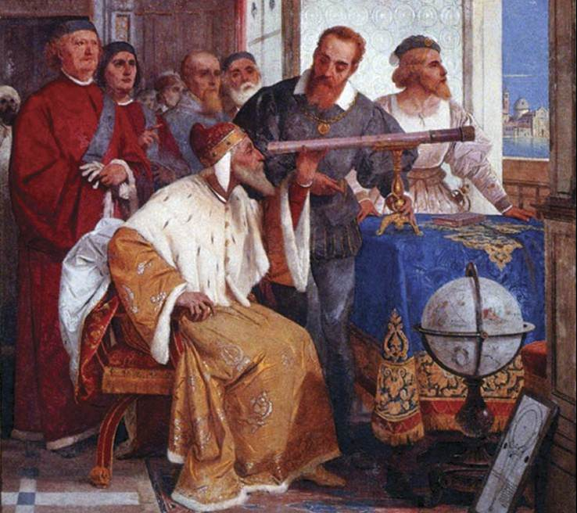
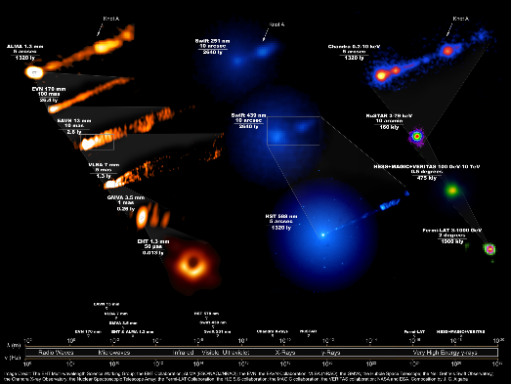
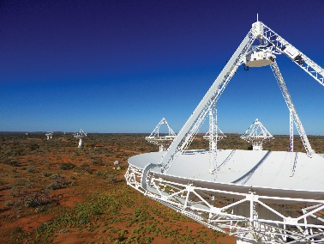
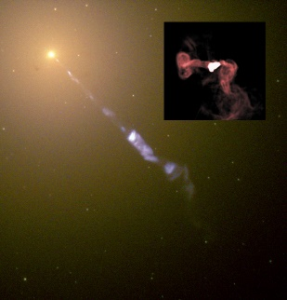
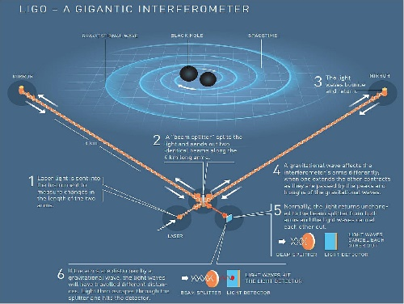
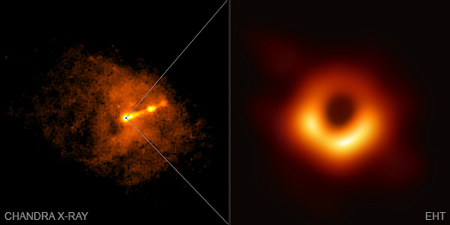
What is a Telescope?
Modern telescopes are essentially data processing machines
Galileo
Radio
Multi messenger
CSIRO - SKA
eventhorizontelescope.org
Giuseppe Bertini (1858)
NASA/Hubble + NRAO: M87

Slide 29

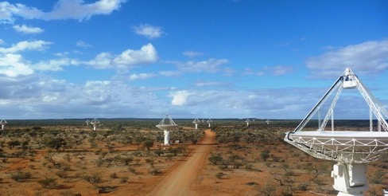
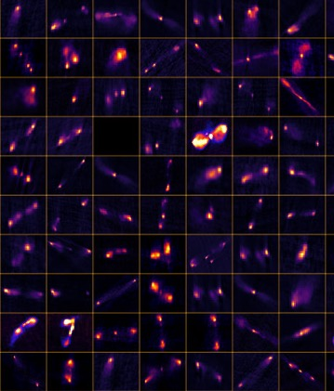
Classification of Radio Galaxies
ML/AI Open Questions and Considerations
Astronomy images are noisy
How to best preprocess?
Have both faint and bright features
Supervised or Unsupervised?
Radio Galaxy Zoo labels (~177k galaxies)
Apply transfer learning?
Train on simulated data
Train on one radio dataset, use on data from a different telescope
Notes:
There are some open questions and considerations around this ML task:
Astronomy images are mostly noise
Questions around how do we preprocess the image, so that the features are seen by the network. Astronomical images can have both bright and faint features.
Questions around whether to use supervised or unsupervised techniques. Do not have labels for all data of course – from RGZ project we have labels for 177k galaxies. Have project using unsupervised self-organised maps to do the radio source component grouping. Showing promise.
Can we apply transfer learning? Train on one radio dataset and use the model on another dataset? Telescopes have different properties such as resolution and sensitivity, and observe at different frequencies.

Slide 30
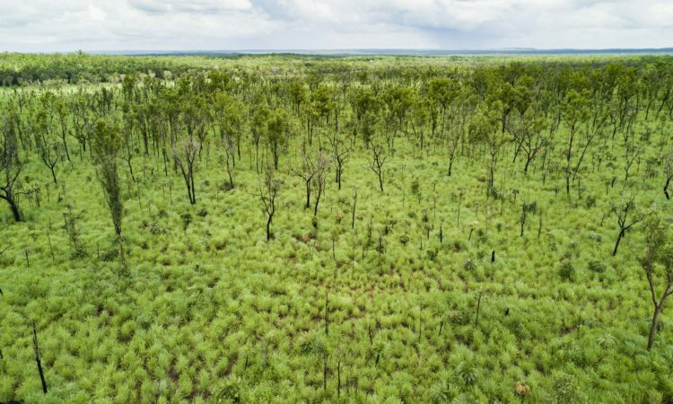
Invasive species mapping
Gamba is an invasive grass
Mapping Gamba grass is essential for biodiversity and bushfire management
Current Challenges:
lack of ground-truth data (labels)
large-scale mapping
Self-Supervised Remote Sensing?

Slide 31

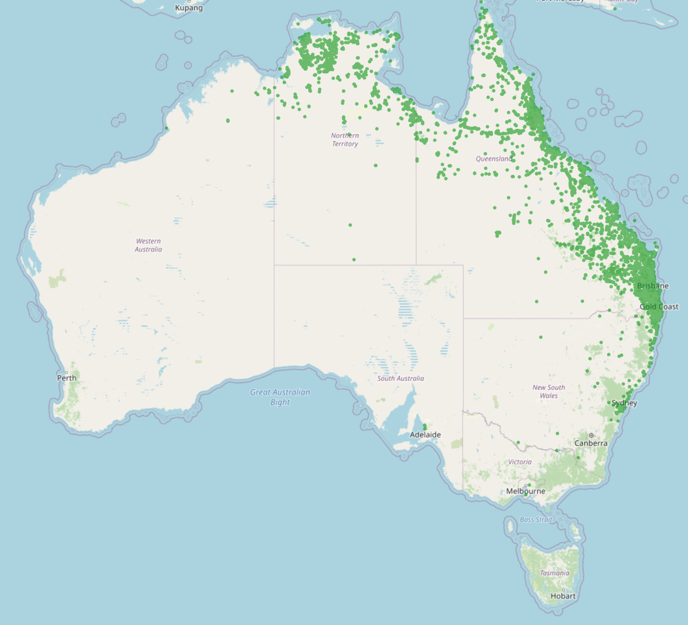
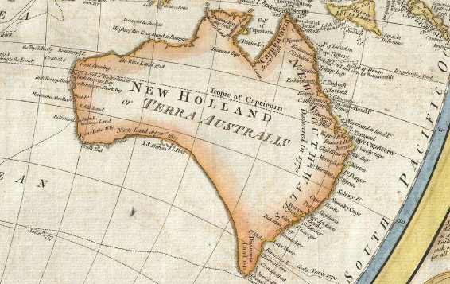
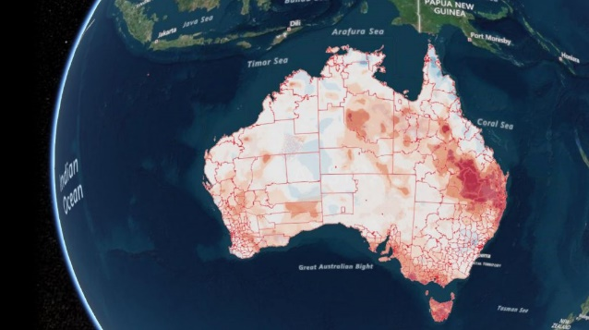
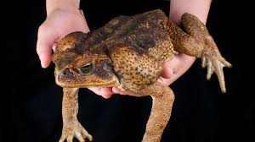
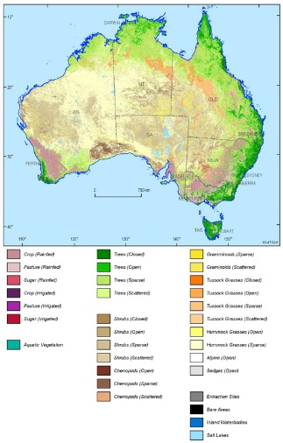


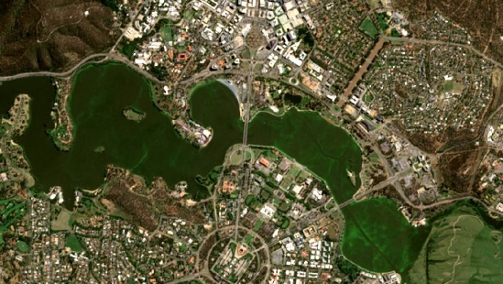
What is a Map?
Modern maps are navigational and surveying instruments
Paper
Electronic
Multi modal
Geoscience Australia
Samuel Dunn (1794)
Canberra Times (11/3/21)
The Guardian (25/2/21)

Slide 32
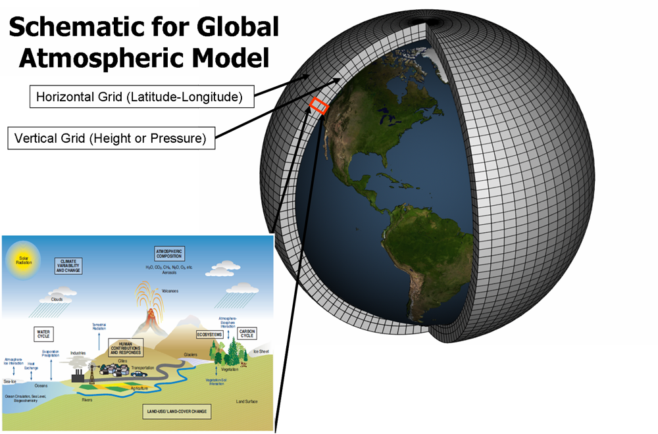
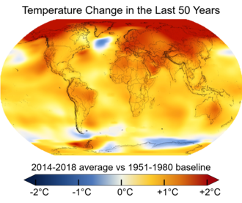
Climate Modelling
Global simulation models
Observations from heterogenous systems
Ocean, atmosphere, sea ice
Different time and space resolutions
Uncertainty propagation
Understanding climate variability, prediction and characterization
E.g. climate response to human action
Large scale latent state space models
Notes:
We are interested in climate models for which we have global simulation models and actual observations of the climate system. These observations can be at a very different time and space resolutions
We would like to model and propagate uncertainty on climate variables accurately by combining different sources of information in order to understand climate variability; make predictions at different horizons and characterize the climate system. For example, what is the climate response to human action

Slide 33
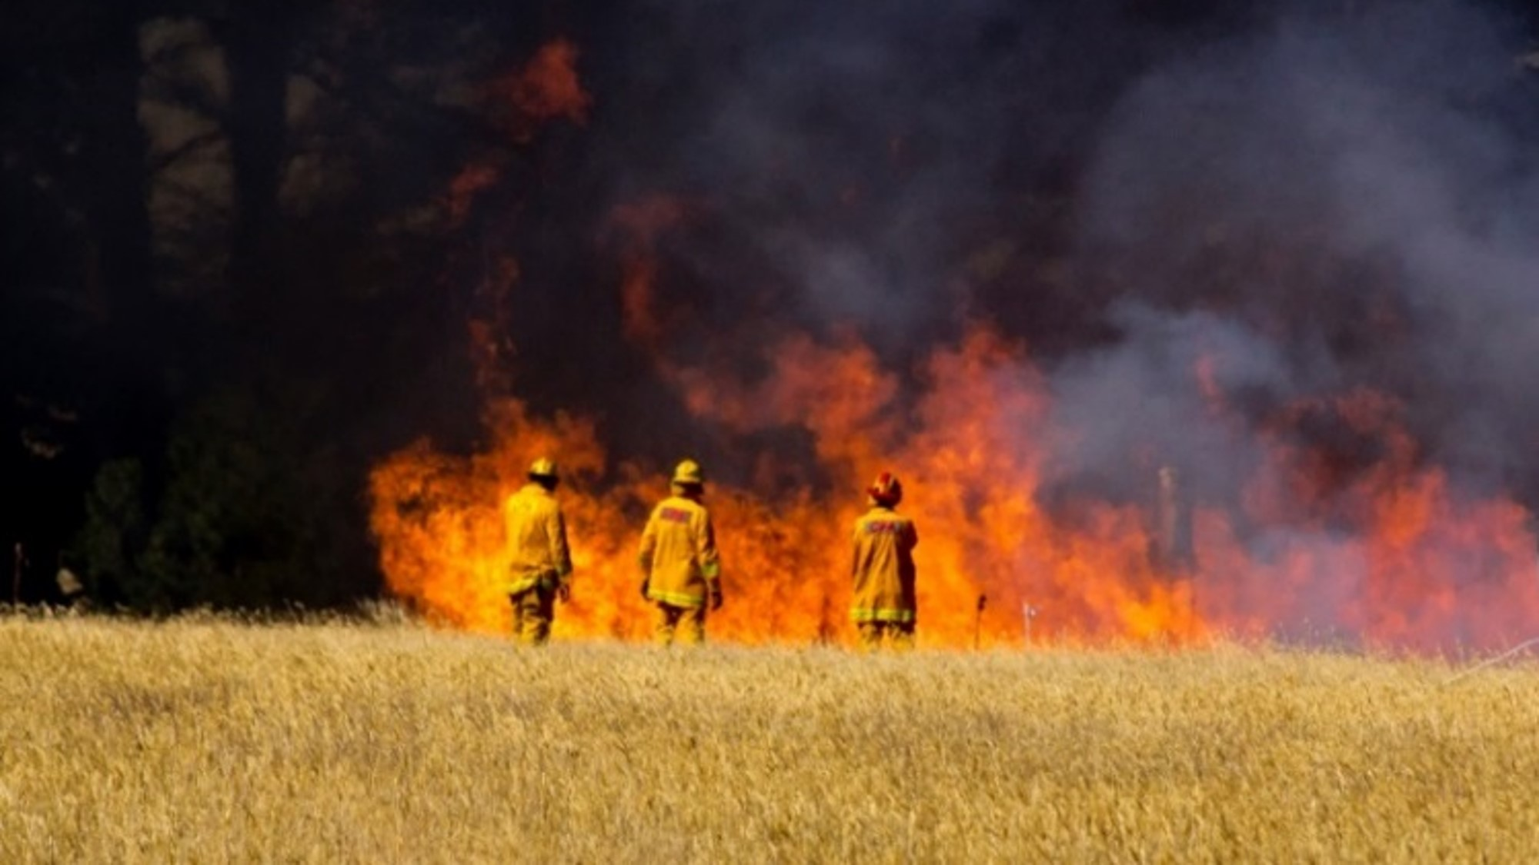

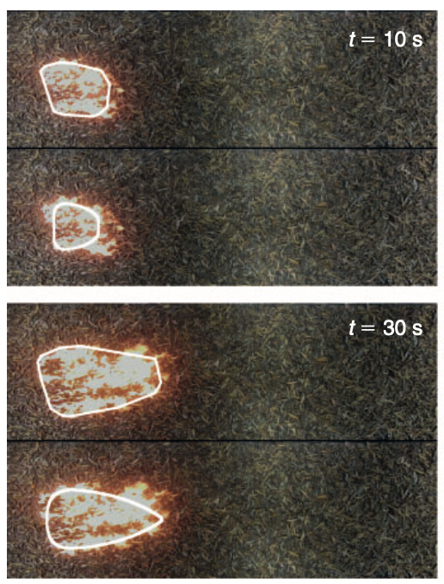
Bushfire Modelling
Key problems
How fast is the fire spreading?
Can we predict where the fire will go and when it will arrive at a given location?
Building predictive models that are a hybrid of data driven statistical machine learning and domain knowledge
Collaborating with CSIRO Data61 and L&W scientists in Victoria and the NT
Notes:
Recent events
Disclaimer
Contents
33

Slide 34
What is a microscope?
Modern biology is a study of systems
Optical
Sequencing
Multi ‘omics
Illumina
Wikipedia
Leica
Oxford nanopore

Slide 35
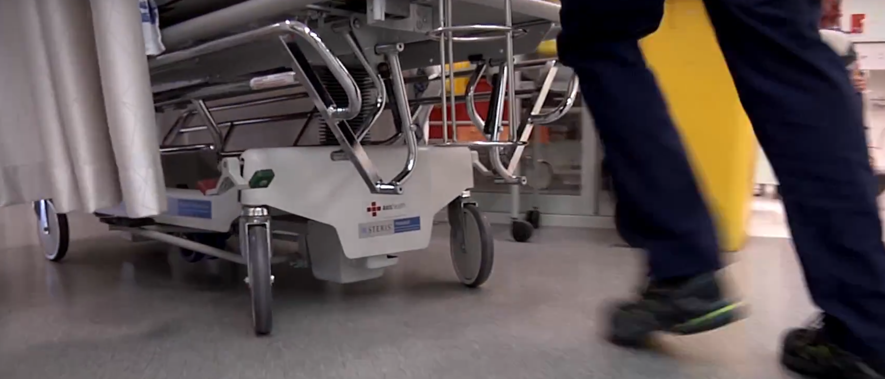
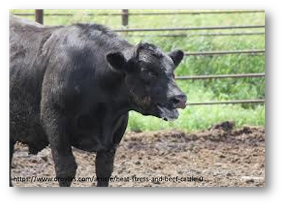

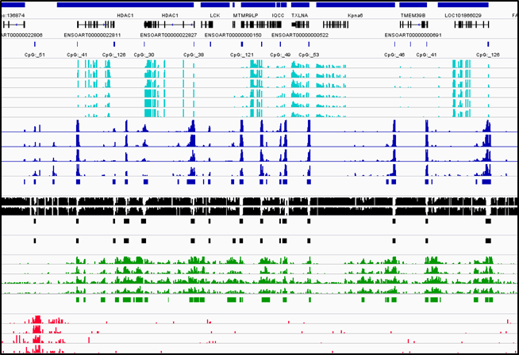
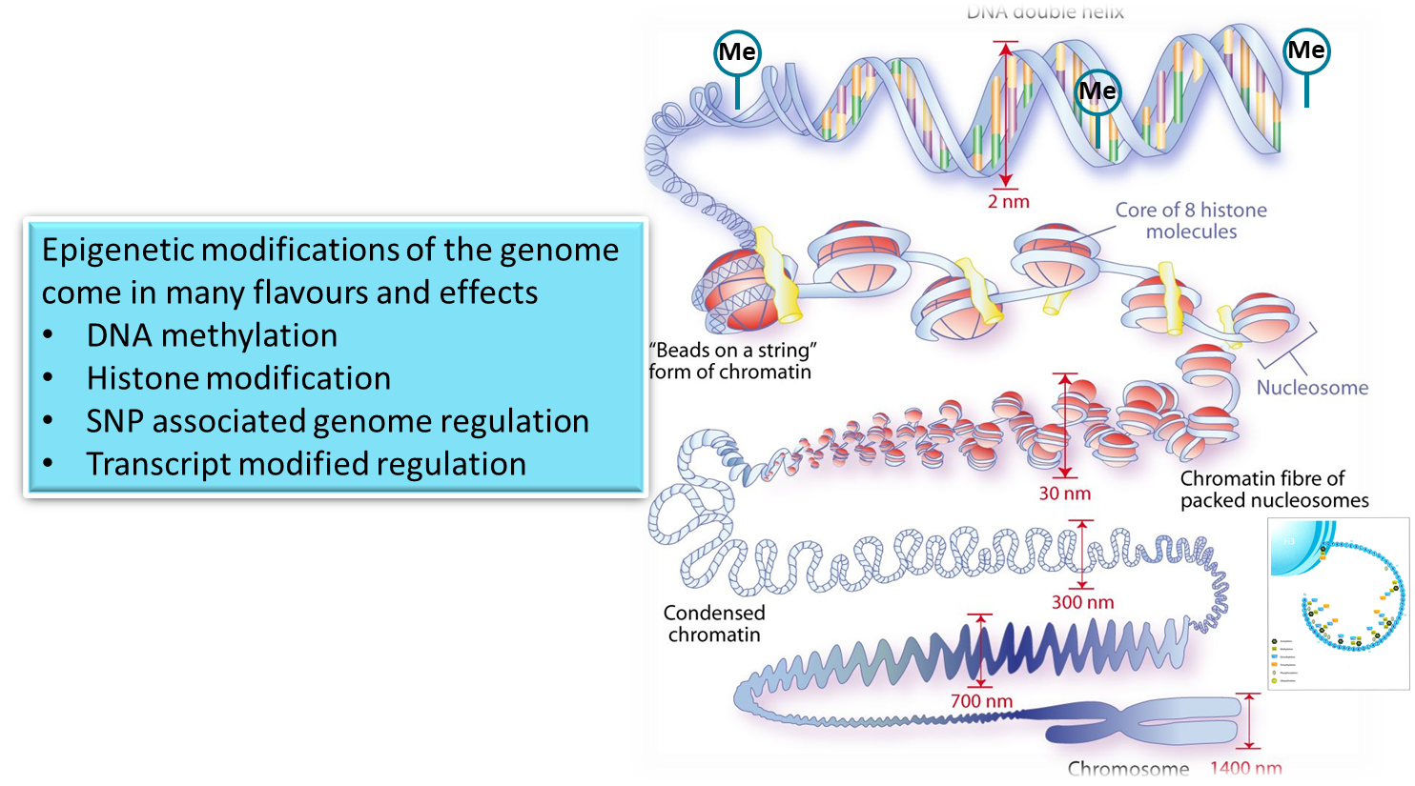
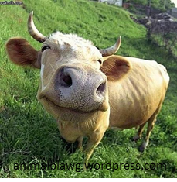

Sequences …
Patient records
Combine medical imaging with doctors’ notes
‘omic signatures of a good life
Can biological data be integrated to predict stress?
SNP

Slide 36
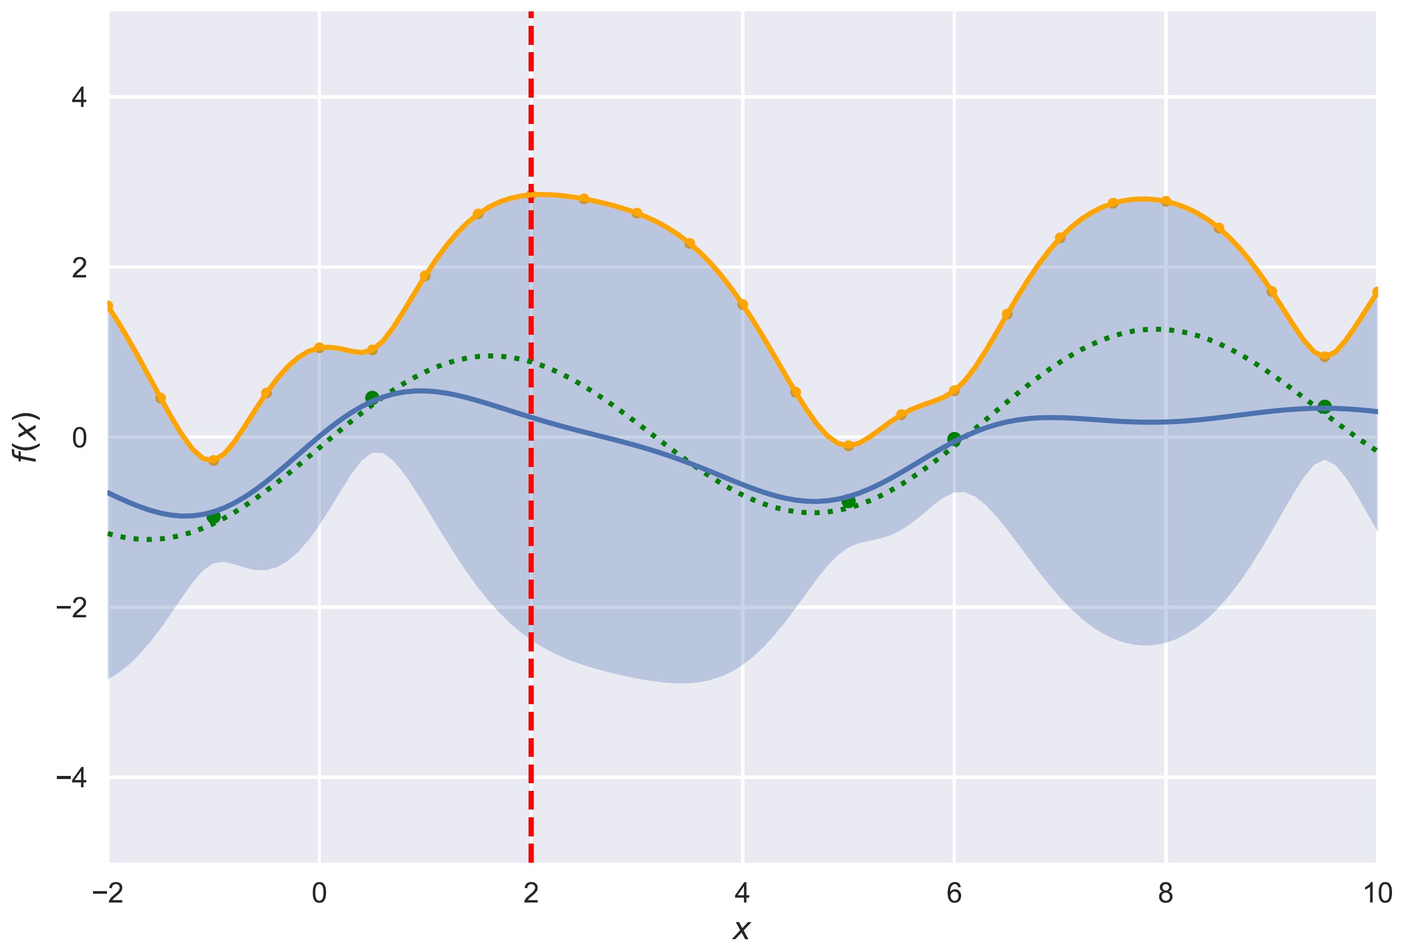

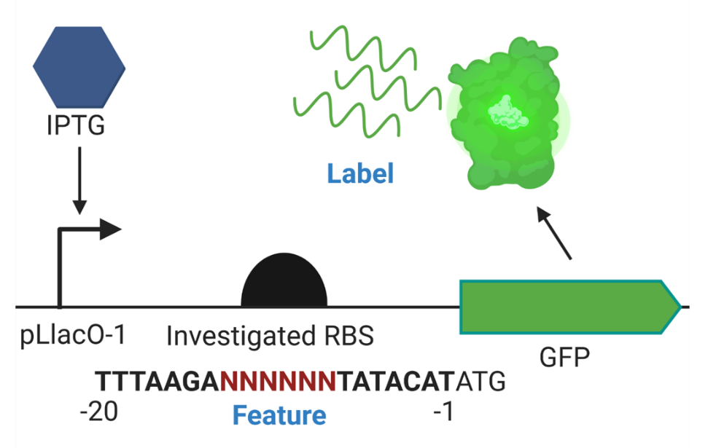
MLAI augmented SynBio
Design better RBS sequences to increase TIR
Ribosome Binding Site (RBS) controls protein expression level​
Translation Initiation Rate of Ribosome (TIR) binding sites is hard to predict and is expensive to label​
Use a predictor (Gaussian process) to estimate TIR for unobserved RBS sequences
Gaussian processes provide predictive uncertainty
Upper Confidence Bound (UCB) algorithm
Balance exploration and exploitation
Choose a batch of 90 constructs per round
https://research.csiro.au/synthetic-biology-fsp
Notes:
CSIRO has invested in another Future Science Platform on Synthetic Biology.
The specific problem we address is to increase the expression of a particular gene by changing the sequence that regulates the gene expression.
There are two regions which regulates expression, the promotor, and the ribosomal binding site (RBS).
There are two machine learning components (for two different MLAI tasks):
Regression. Gaussian process to do regression from RBS to TIR. In other words, for a given RBS sequence, predict TIR (the amount of gene expressed / how green it glows) A GP provides the mean as well as the predictive uncertainty. This is shown in the plots by the dark blue line and the light blue shaded area. Note that the true function is orange (and unknown)
Adaptive Design. We want to propose designs that maximise the value of the TIR (how green?). The upper confidence bound algorithm trades off exploration and exploitation. The two plots show one step of the algorithm. In the left plot, we select the green point, which has very high uncertainty (note broad confidence region). When we measure the value (shown on the right), we see that it is very low, and hence our regressor (the GP) updates its predictions. This leads to the next round where we select a different test point.

Slide 37
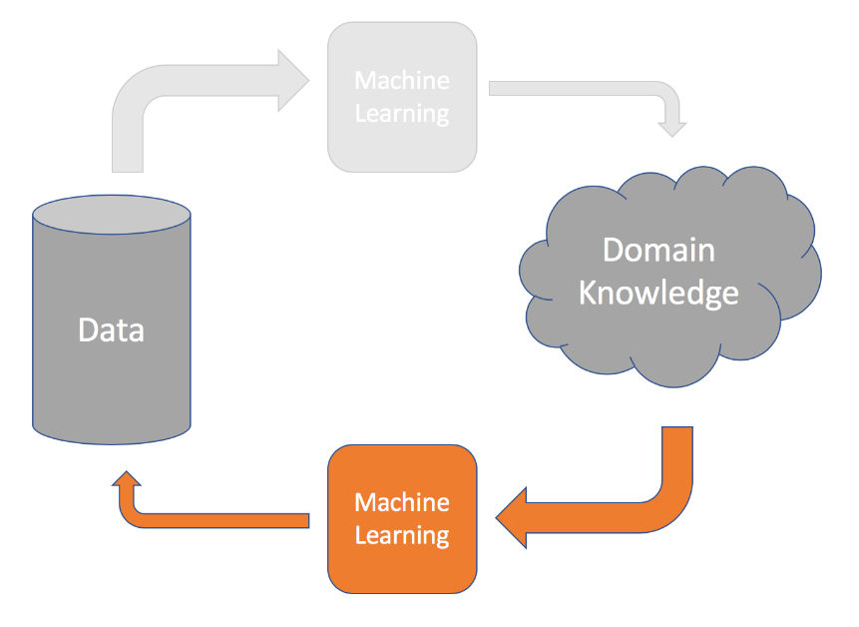
What is data?

Slide 38
Data is measured for a reason
A conceptual view of adaptive sampling
Consider the set of all possible things to measure
Think of the predictor output as a generator of features
Each generated features demonstrates the “importance” of a sample
Can get multiple features by a committee or ensemble of predictors
Adaptively choose the next thing to measure by maximising an objective (machine learning is about defining good objective functions)
hyperparameters
regularizer
sparsity
bandwidth

Slide 39
Summary
What is the next generation scientific instrument?
Scientific discovery is an iterative process between data and knowledge
We observe data to infer new knowledge
Use machine learning to predict/infer unobserved data
We use domain knowledge to design new ways to capture data
Telescopes (like SKA) don’t look like tubes with glass
What are the next scientific instruments that rely on mathematics, statistics, and computing?
Notes:
Key message: Figure out how to use machine learning to assist researchers in scientific discovery.

Slide 40
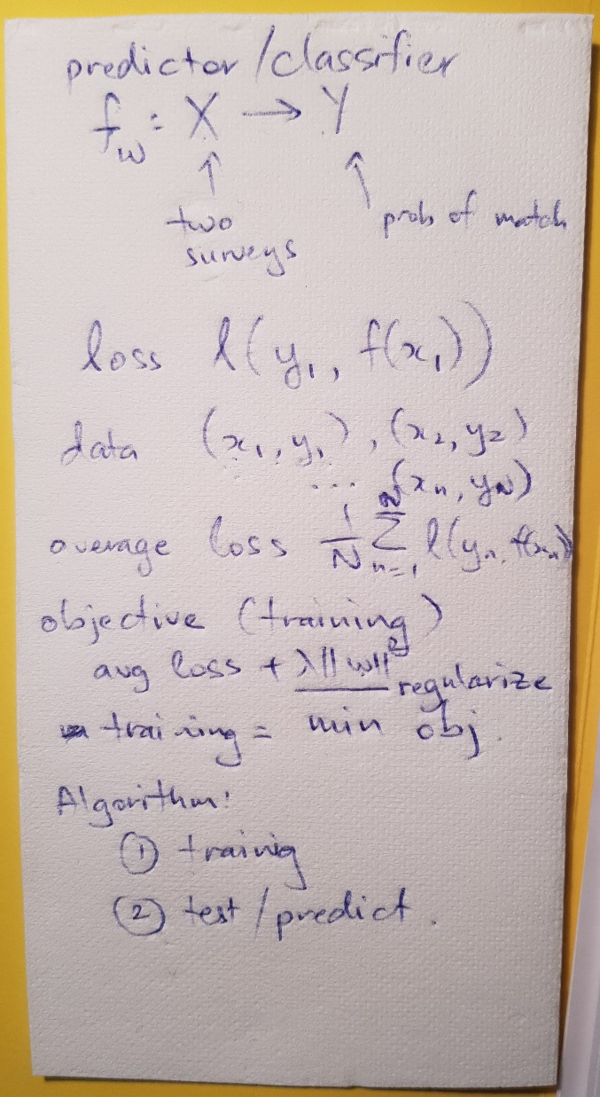
Parting thought…
The TV chef problem
“Actually running logistic regression, after feature vectors and labels were all set up, went particularly fast, leading to the remark: ‘and I thought machine learning was difficult’!
In this lies what I identify as the ‘TV Chef Problem’: if all the ingredients are prepared earlier, the task looks easy. However, this hides that sourcing and preparing those ingredients, as well as determining if you’ve even got the right recipe, is where the real difficulty and ambiguity lies.
Watching the TV Chef is effortless, but answering ‘is this meal right?’ can be really hard”
James Gardner, ANU undergraduate

Slide 41




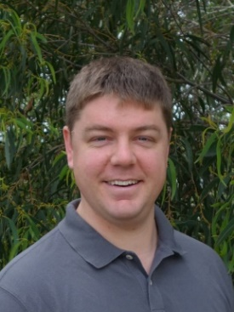



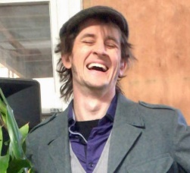



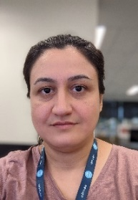
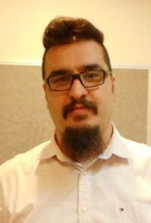
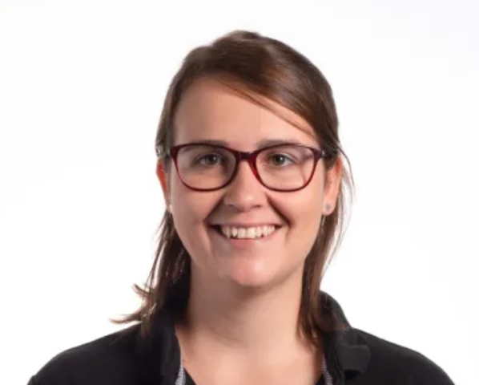


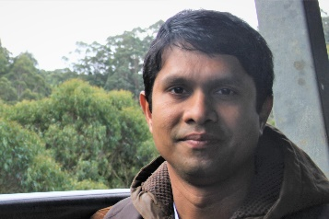
Come work with us
Machine Learning for Scientific Discovery
Work with an interdisciplinary group of EMCRs on challenging real world problems
Develop new methods at the interface between statistics and MLAI
Publish, network, and pitch new ideas
Have impact on industrial, environmental and agricultural programs
Open positions at https://jobs.csiro.au/
cheng-soon.ong@data61.csiro.au
https://research.csiro.au/mlai-fsp/

